Slide 1
Statistics for Graduate Students: Lecture #3
Why most published findings are false?
Statistical power
One-way ANOVA
Two-way ANOVA

Slide 2
Inference Errors II Why “most published findings are false”?

Slide 3
Reminder: Inference errors
NHST tools are inherently probabilistic.
We compute p(observed result or a more extreme observation | H0) and reject H0 if p(observed result or a more extreme observation | H0) < alpha.
As in any probabilistic decision, NHST by-definition includes some probability for errors.
In fact, a key idea behind NHST is to keep error rates set to a given value – to “control” for error rates (yet unfortunately, it doesn’t always happen).
Two types of errors: Type I vs. Type II.

Slide 4
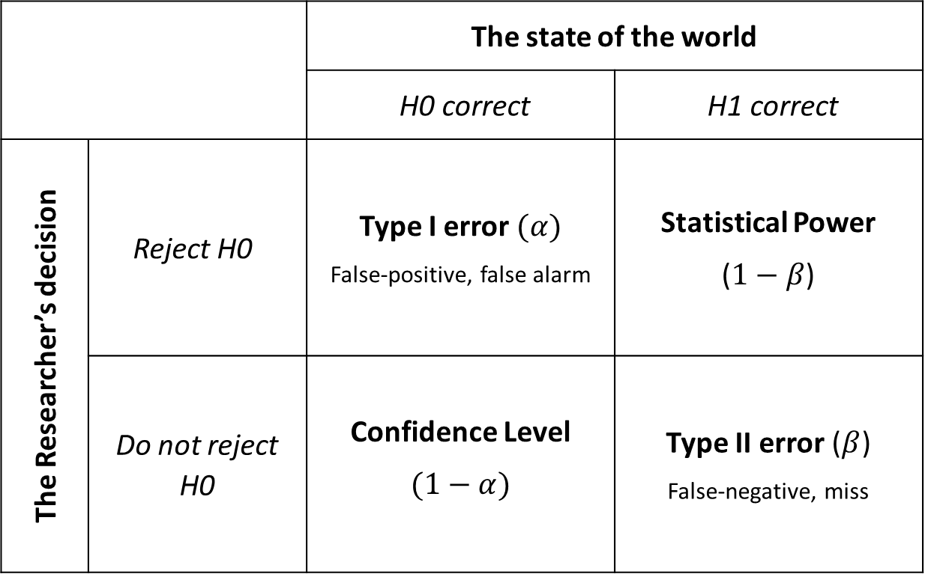
Reminder: Inference errors
The state of the world
H1 correct | H0 correct
Statistical Power ($1−β$) | Type I error $(α)$ False-positive, false alarm | Reject H0 | The Researcher’s decision
Type II error ($β$) False-negative, miss | Confidence Level $$(1−α)$$ | Do not reject H0

Slide 5
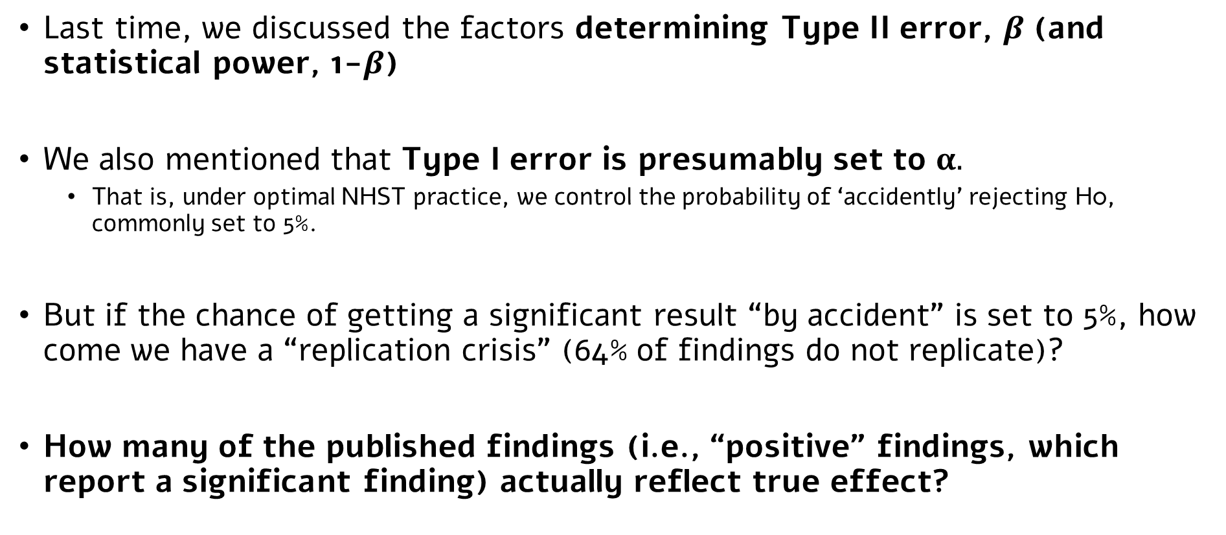
Reminder: Inference errors
Last time, we discussed the factors determining Type II error, $β$ (and statistical power, 1-$β$)
We also mentioned that Type I error is presumably set to $α.$
That is, under optimal NHST practice, we control the probability of ‘accidently’ rejecting H0, commonly set to 5%.
But if the chance of getting a significant result “by accident” is set to 5%, how come we have a “replication crisis” (64% of findings do not replicate)?
How many of the published findings (i.e., “positive” findings, which report a significant finding) actually reflect true effect?

Slide 6
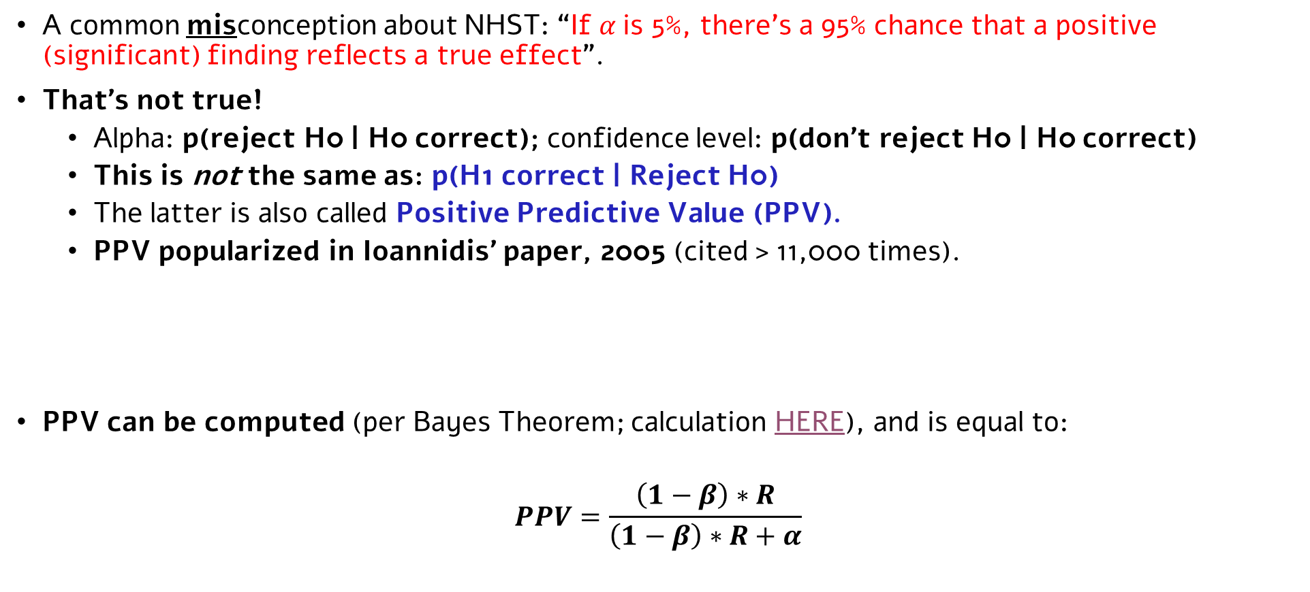
How many published findings reflect true effects?
A common misconception about NHST: “If $α$is 5%, there’s a 95% chance that a positive (significant) finding reflects a true effect”.
That’s not true!
Alpha: p(reject H0 | H0 correct); confidence level: p(don’t reject H0 | H0 correct)
This is not the same as: p(H1 correct | Reject H0)
The latter is also called Positive Predictive Value (PPV).
PPV popularized in Ioannidis’ paper, 2005 (cited > 11,000 times).
PPV can be computed (per Bayes Theorem; calculation HERE), and is equal to:
$$PPV=\frac{\left(1−β\right)∗R}{\left(1−β\right)∗R+α}$$

Slide 7
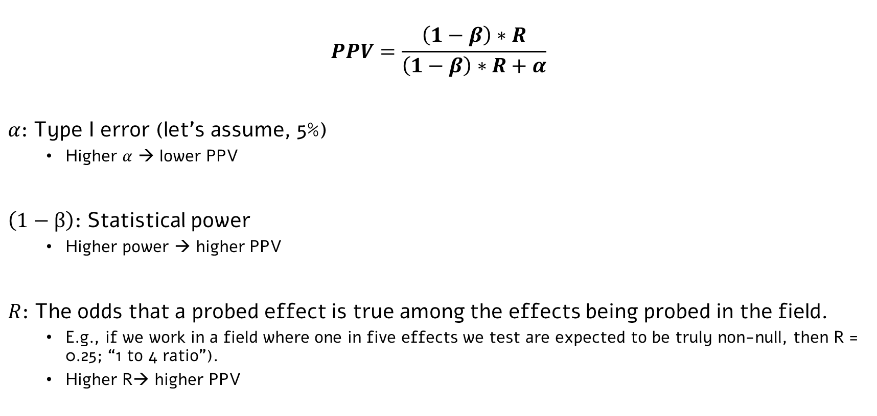
PPV: unpacked
$$PPV=\frac{\left(1−β\right)∗R}{\left(1−β\right)∗R+α}$$
$α$: Type I error (let’s assume, 5%)
Higher $α$ → lower PPV
$\left(1−β\right)$: Statistical power
Higher power → higher PPV
$R$: The odds that a probed effect is true among the effects being probed in the field.
E.g., if we work in a field where one in five effects we test are expected to be truly non-null, then R = 0.25; “1 to 4 ratio”).
Higher R→ higher PPV

Slide 8
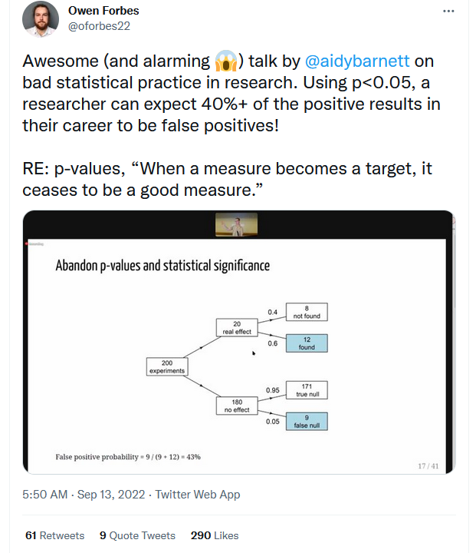
One concrete example
Simply a PPV calculation for odds of 1/9* and a power of 60%.
*Odds of 1/9 are pessimistic, but the point holds.

Slide 9
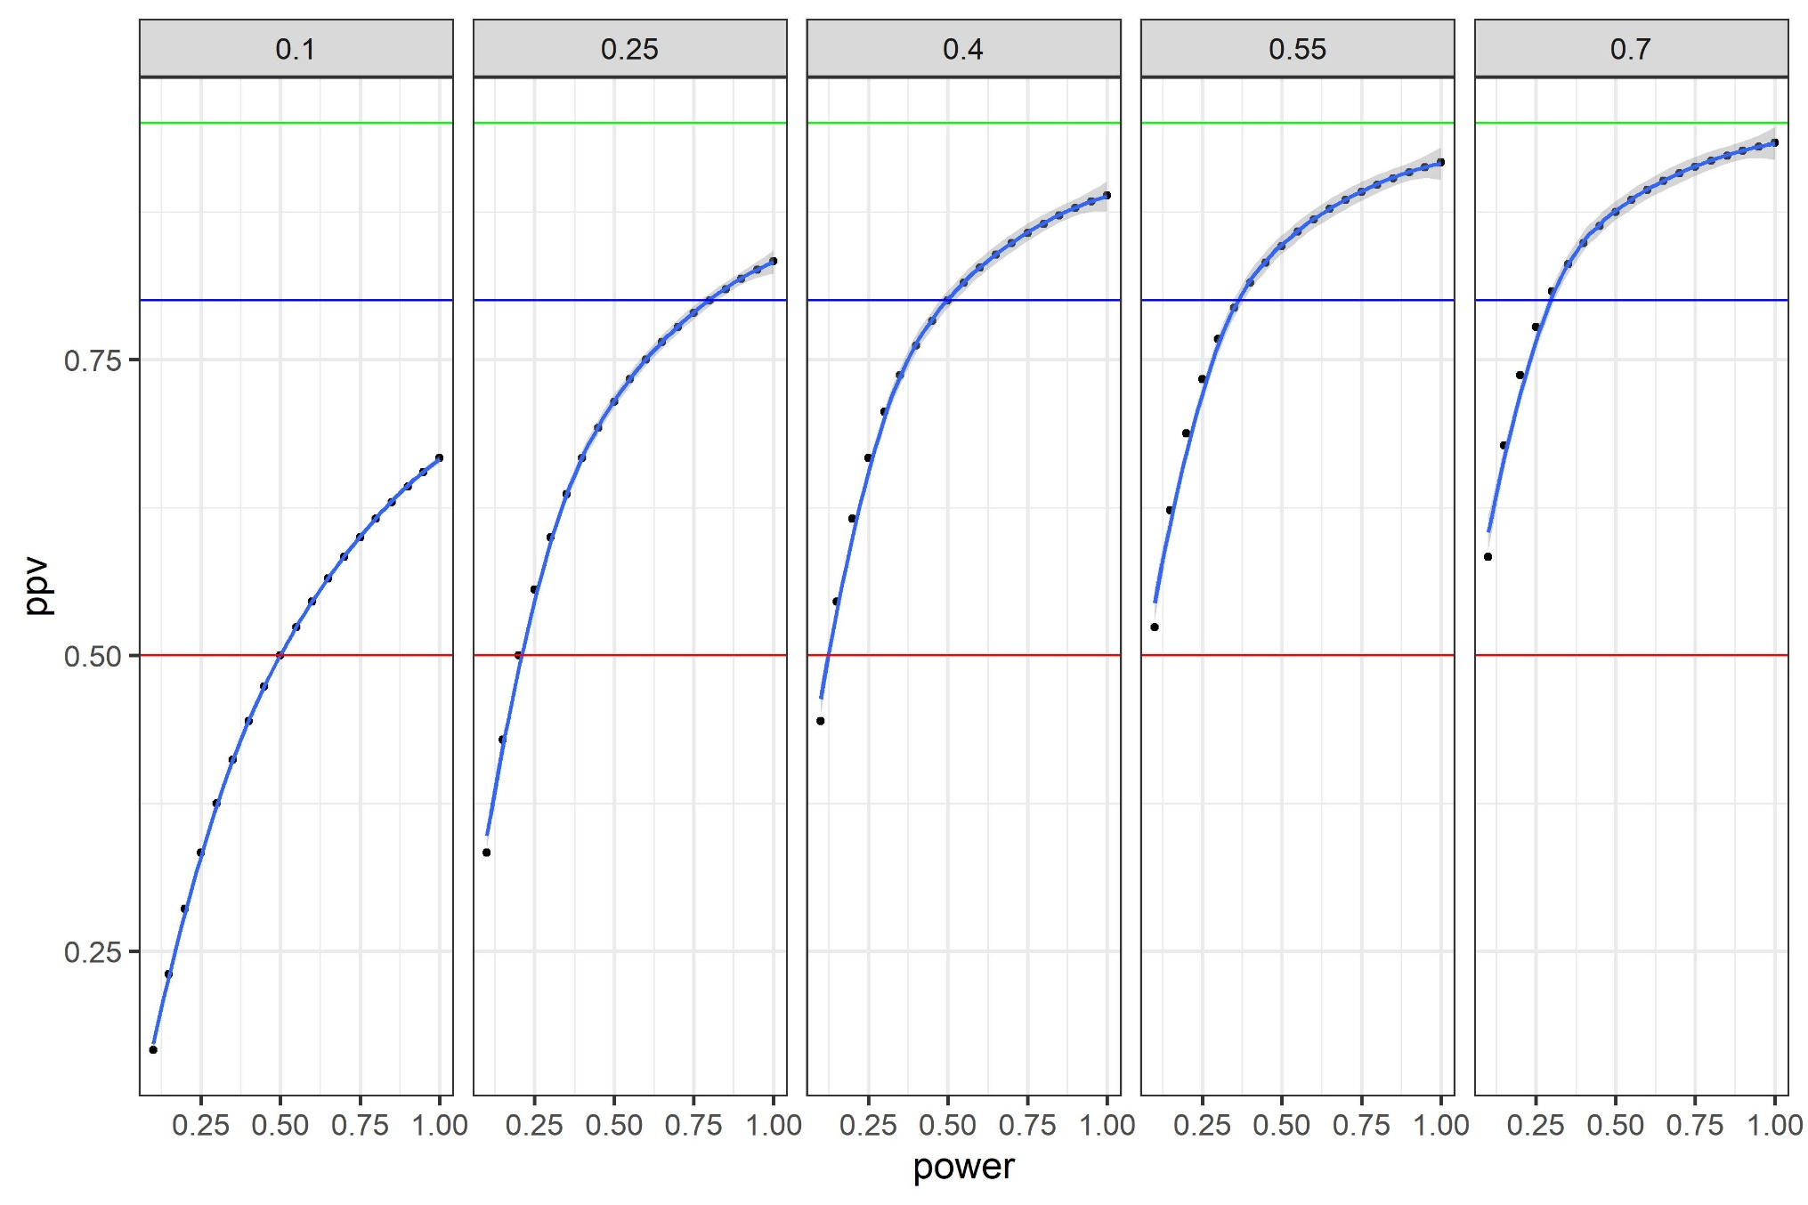
PPV: Implications
All: alpha=5%
Panels: R (odds)
PPV=0.95
PPV=0.8
PPV=0.5

Slide 10
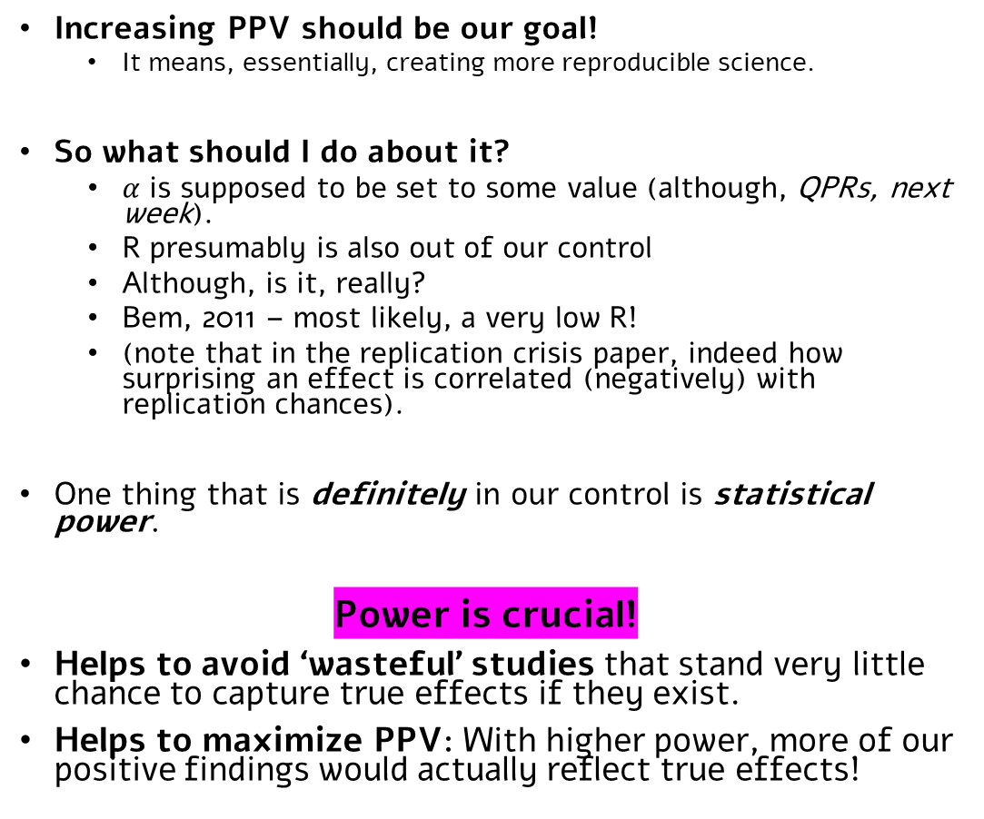

Why should I care?
$$PPV=\frac{\left(1−β\right)∗R}{\left(1−β\right)∗R+α}$$
Increasing PPV should be our goal!
It means, essentially, creating more reproducible science.
So what should I do about it?
$α$ is supposed to be set to some value (although, QPRs, next week).
R presumably is also out of our control
Although, is it, really?
Bem, 2011 – most likely, a very low R!
(note that in the replication crisis paper, indeed how surprising an effect is correlated (negatively) with replication chances).
One thing that is definitely in our control is statistical power.
Power is crucial!
Helps to avoid ‘wasteful’ studies that stand very little chance to capture true effects if they exist.
Helps to maximize PPV: With higher power, more of our positive findings would actually reflect true effects!

Slide 11
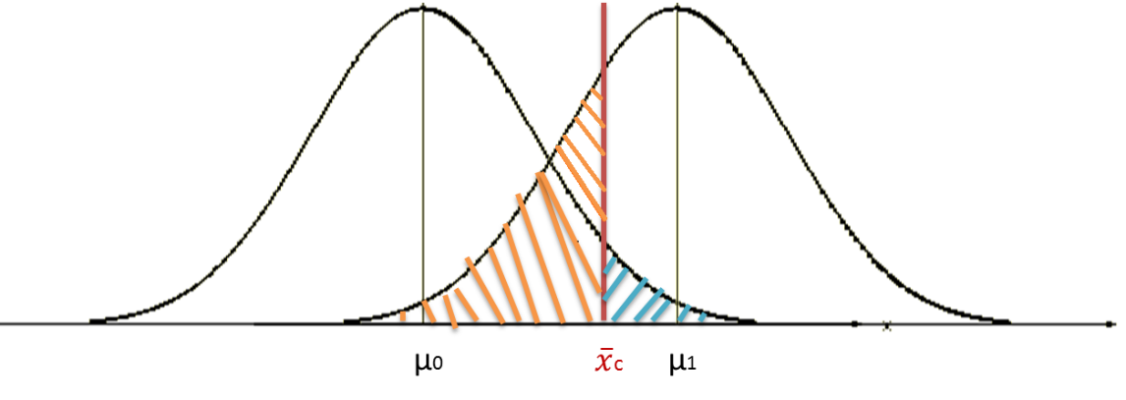
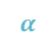
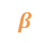
Increasing statistical power
$$β$$
$$α$$
The most common way to ensure high statistical power is to have a suitable sample size in our design*:
For a given statistical test, and assuming a given population effect size and a given sample size, we can compute statistical power.
In many cases there are algebraic solutions (but not always).
These calculations are the basis for a very useful tool: Power analysis.
The common use - prospective power analysis: Determining, before the study, the N needed to observe an effect of a given size at a given probability.
Typically, assume an effect size based on previous studies (ideally, meta-analysis); sometimes, assume a ‘minimal’ meaningful effect size (e.g., d = 0.2, “small” effect size).
Use a target value for power that is high enough (commonly – 80%).
*Not the only way; see one more thing to do, here.

Slide 12
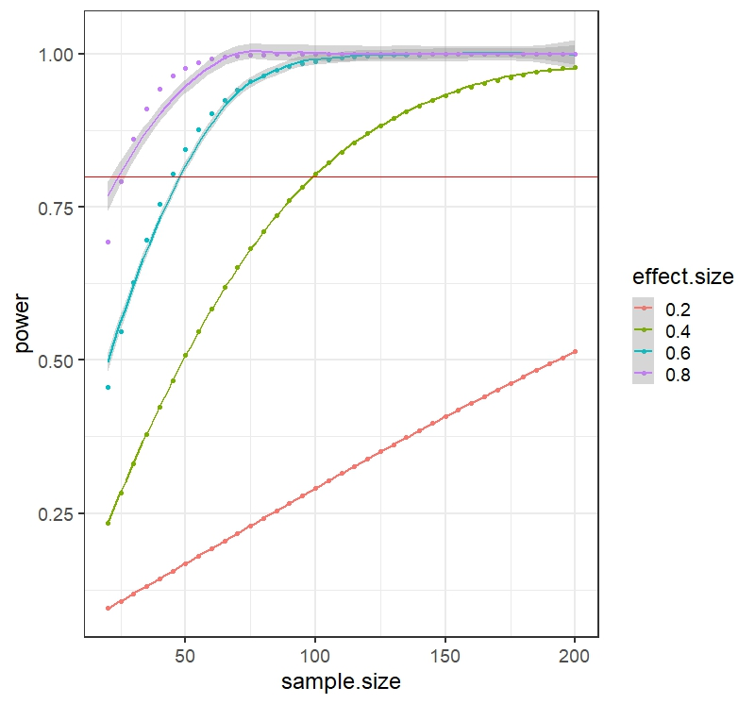
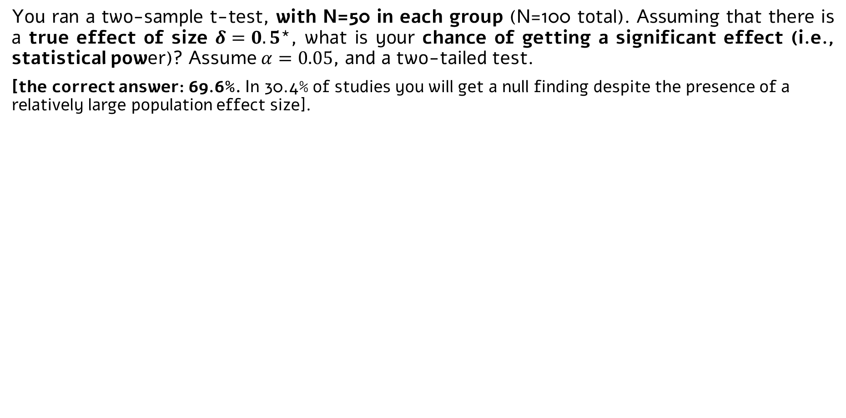
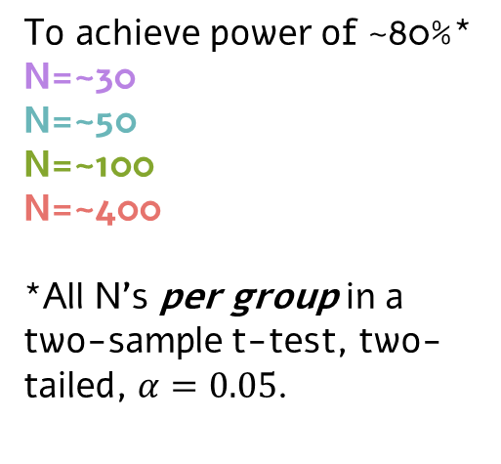
Some intuitions about power
You ran a two-sample t-test, with N=50 in each group (N=100 total). Assuming that there is a true effect of size $δ=0.5$*, what is your chance of getting a significant effect (i.e., statistical power)? Assume $α=0.05$, and a two-tailed test.
[the correct answer: 69.6%. In 30.4% of studies you will get a null finding despite the presence of a relatively large population effect size].
Power may be lower than you think!
To achieve power of ~80%*
N=~30
N=~50
N=~100
N=~400
*All N’s per group in a two-sample t-test, two-tailed, $α=0.05$.
*Probably larger than most psychological phenomena, see here

Slide 13
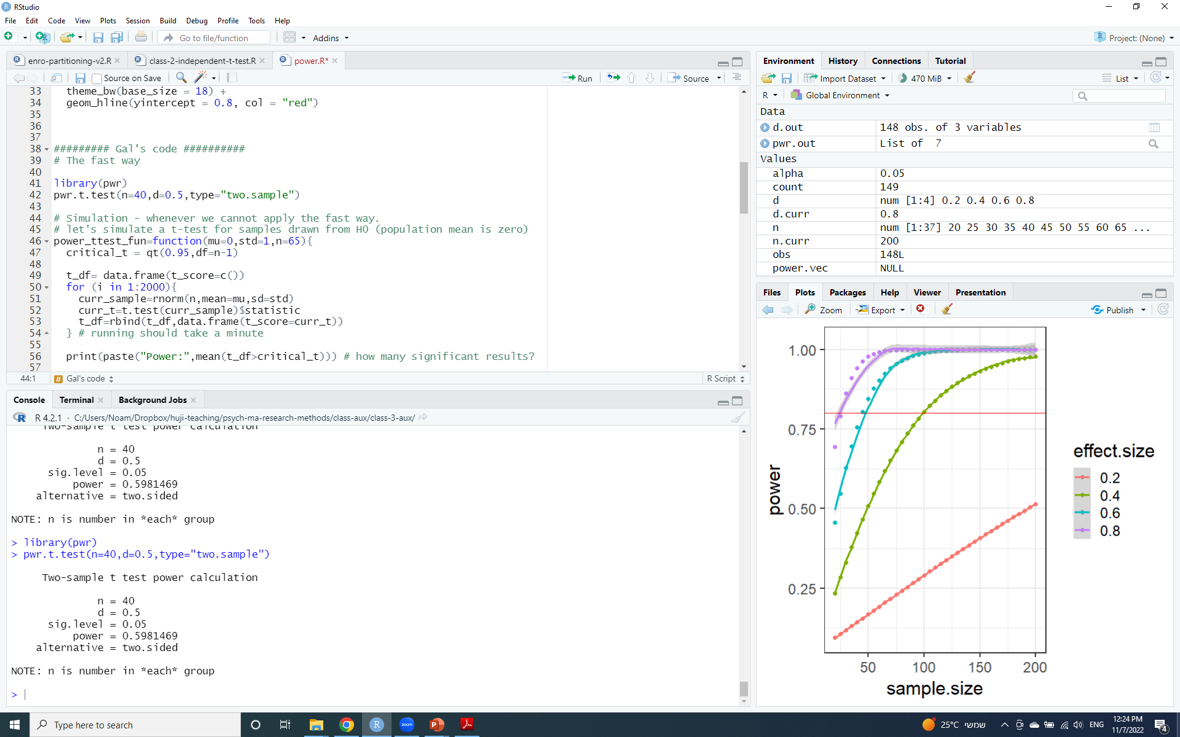
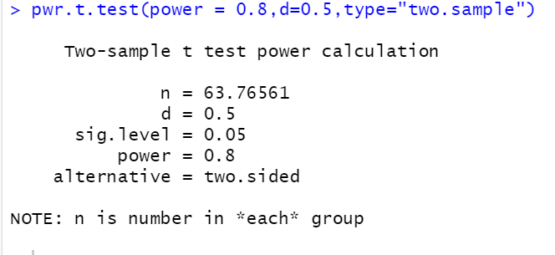
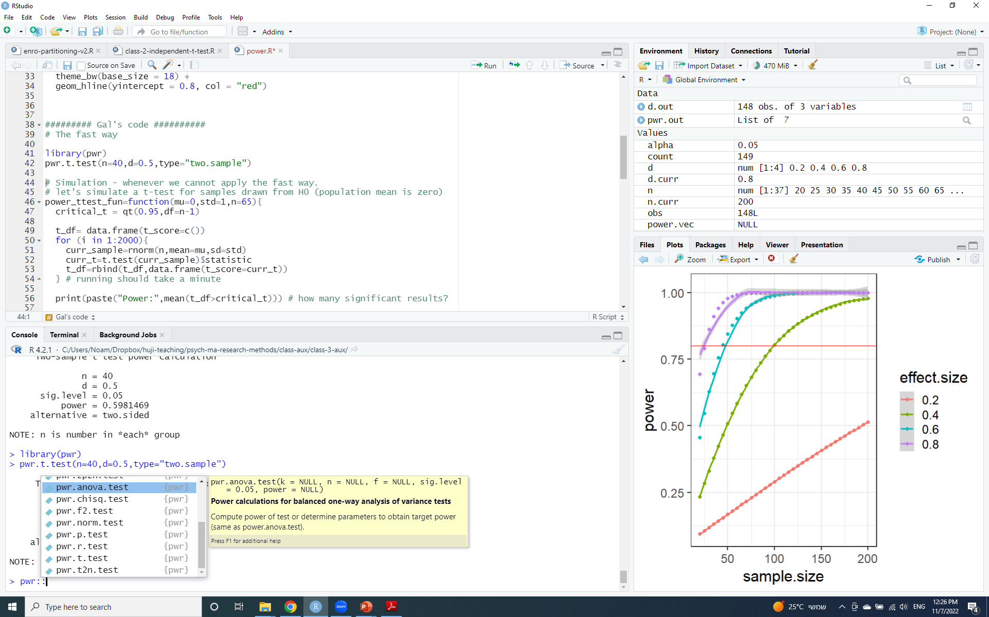
Power analysis in R
Look at ?pwr.t.test for more options!
E.g., one-tailed test, one-sample, var.equal, etc.
The quick way - off-the-shelf packages:
Power analysis for many other statistical tests, too:

Slide 14
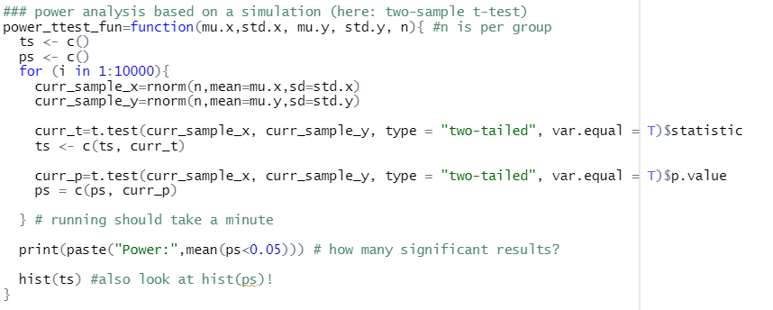
Power analysis in R
The long way – simulations!

Slide 15
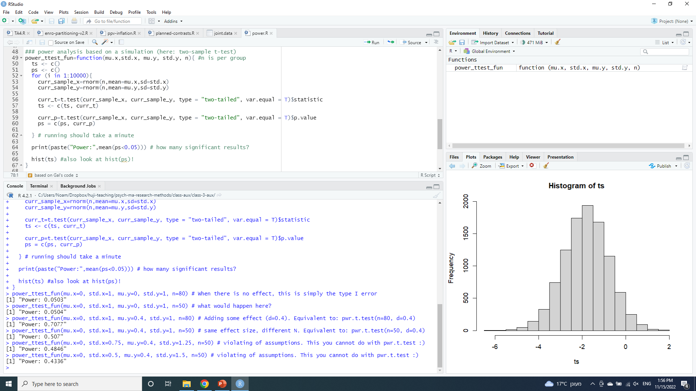
Power analysis in R
The long way – simulations!
(1)
When there’s no effect – this is Type I error.
Note: the word ‘power’ is misleading here!
(2)
Type I error rate (alpha) unrelated to sample size
(3)
Population effect size, delta=0.4;
Same as: pwr.t.test(d=0.4, n=80)
(4)
Same effect delta, but smaller N, hence lower power.
Same as: pwr.t.test(d=0.4, n=50)
(5)
Impact of violation of assumptions on power
This you cannot do with pwr.t.test ☺

Slide 16
Back to Ioannidis…
How did Ioannidis reach the “most published findings are false” claim?
A PPV calculation based on what he sees as reasonable assumptions about R and power + two additional factors:
“Bias” (“[…] manipulation in the analysis or reporting of findings […] [s]elective or distorted reporting”; now more commonly known as Questionable Research Practices; more on that next week!)
Parallel work by multiple groups (when only positive findings are published; “file-drawer” problem)
Higher bias/more “file-drawer” issues → lower PPV.
Under what Ioannidis claims are reasonable assumptions, PPV < 0.5.
We will discuss these issues (and how to avoid them) next week.

Slide 17
PPV: Implications
All: alpha=5%
Panels: R (odds)
PPV=0.95
PPV=0.8
PPV=0.5

Slide 18
Back to Ioannidis…
How did Ioannidis reach the “most published findings are false” claim?
A PPV calculation based on what he sees as reasonable assumptions about R and power + two additional factors:
“Bias” (“[…] manipulation in the analysis or reporting of findings […] [s]elective or distorted reporting”; now more commonly known as Questionable Research Practices; more on that next week!)
Parallel work by multiple groups (when only positive findings are published; “file-drawer” problem)
Higher bias/more “file-drawer” issues → lower PPV.
Under what Ioannidis claims are reasonable assumptions, PPV < 0.5.
We will discuss these issues (and how to avoid them) next week.

Slide 19
A final note: One more thing to consider…
Benjamin et al., 2018, Nature Human Behavior
Their suggestion: Instead of $α$=0.05, set $α$=0.005

Slide 20
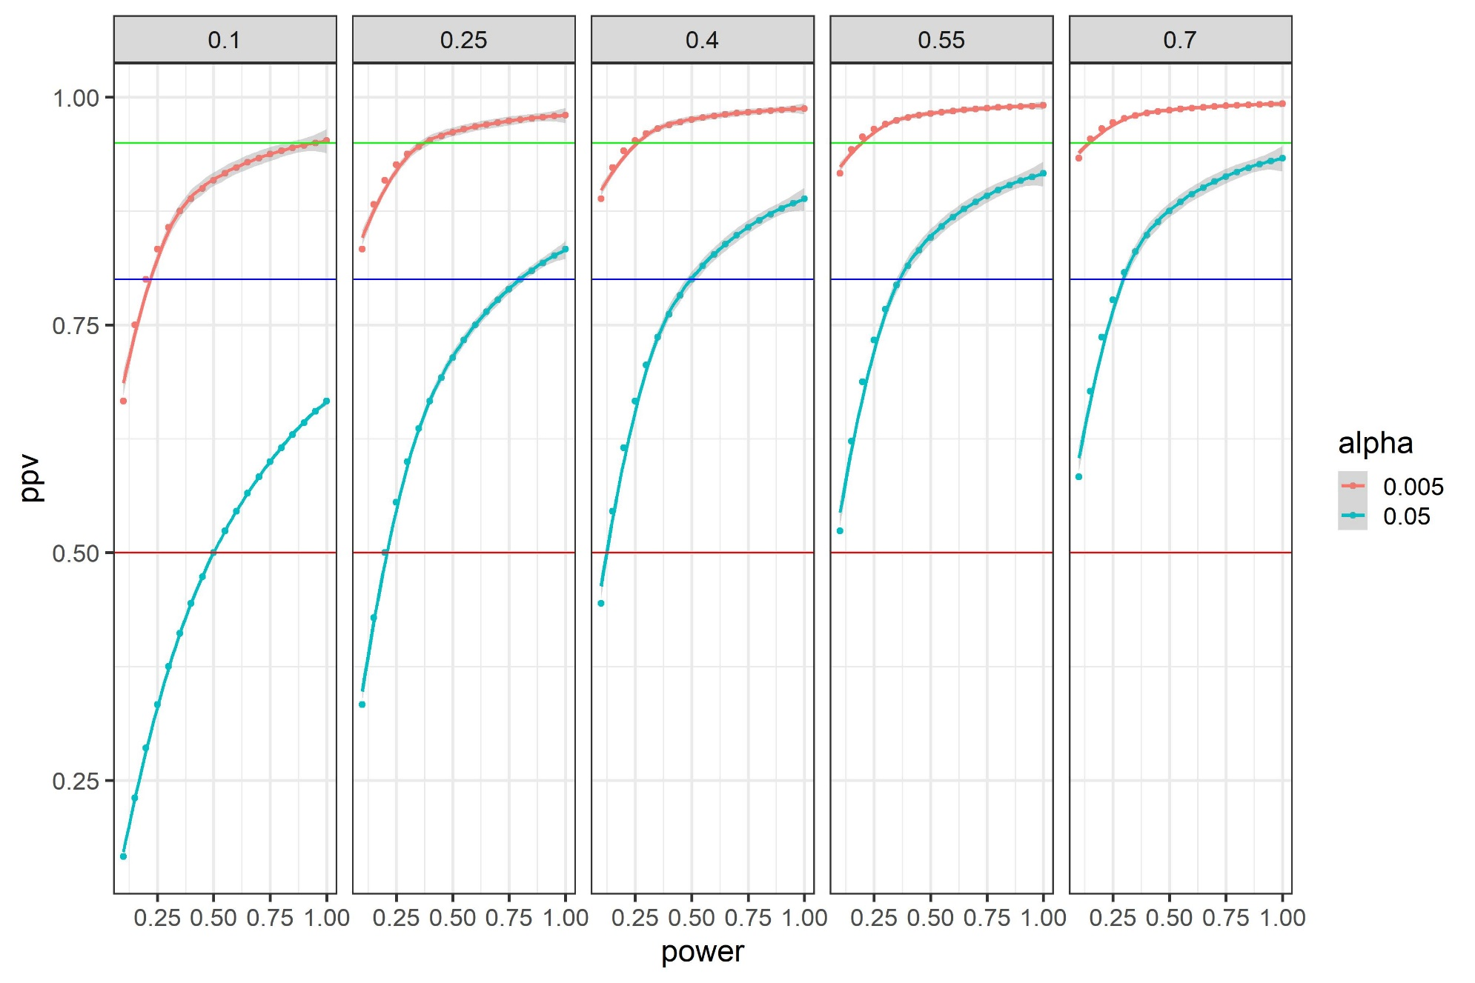
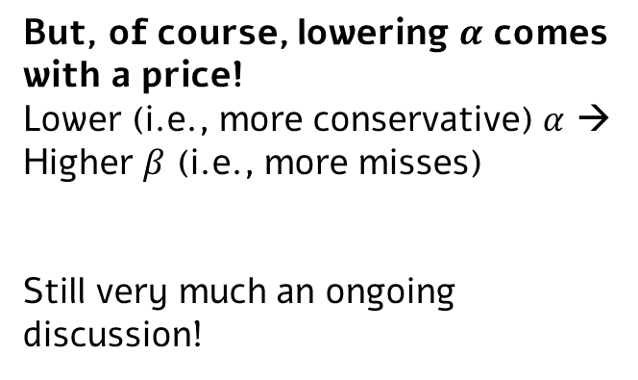
Impact of alpha on PPV
But, of course, lowering $α$ comes with a price!
Lower (i.e., more conservative) $α$ →
Higher $β$ (i.e., more misses)
Still very much an ongoing discussion!

Slide 21
One-way ANOVA

Slide 22
When to use a one-way ANOVA?
Last time - two-sample t-test: Examining the impact of a categorical independent variable with two levels (e.g., yes/no treatment, red/non-red words…) on a continuous dependent variable.
Today: One-way ANOVAs:
Still a continuous dependent variable
Still a categorical independent variable
But: More than two levels for our IV.
E.g., priming experiments with more than 2 conditions, grammatical category (nouns/verbs/adjectives), type of intervention (CBT, meditation, control)…

Slide 23
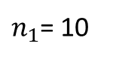
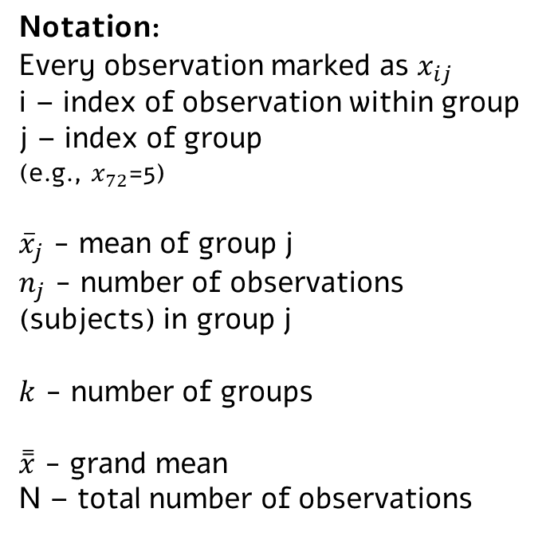
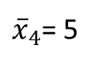
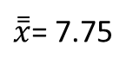
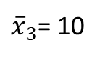
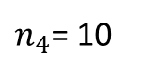
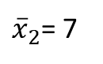
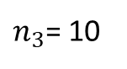
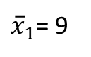
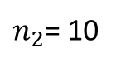
An example: City of residence and depression
Notation:
Every observation marked as $x_{ij}$
i – index of observation within group
j – index of group
(e.g., $x_{72}$=5)
${\overline{x}}_{j}$ - mean of group j
$n_{j}$ - number of observations (subjects) in group j
$k$ - number of groups
$\overset{̿}{x}$ - grand mean
N – total number of observations
Nashville (4) | Seattle (3) | Los Angeles (2) | New York City (1)
1 3 6 1 8 4 0 12 8 7 | 12 14 4 10 15 8 7 5 9 16 | 3 4 6 8 12 14 5 9 6 3 | 6 7 11 12 7 9 13 4 18 3
${\overline{x}}_{1}$= 9
${\overline{x}}_{2}$= 7
${\overline{x}}_{3}$= 10
${\overline{x}}_{4}$= 5
$n_{1}$= 10
$n_{2}$= 10
$n_{3}$= 10
$n_{4}$= 10
$\overset{̿}{x}$= 7.75

Slide 24
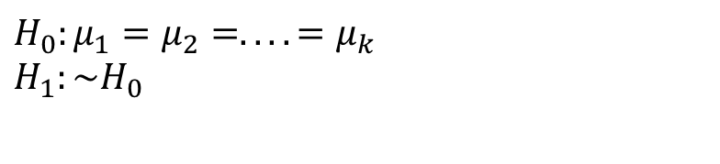
An example: City of residence and depression
We want to test whether city of residence impacts depression levels.
Nashville (4) | Seattle (3) | Los Angeles (2) | New York City (1)
1 3 6 1 8 4 0 12 8 7 | 12 14 4 10 15 8 7 5 9 16 | 3 4 6 8 12 14 5 9 6 3 | 6 7 11 12 7 9 13 4 18 3
$$H_{0}:μ_{1}=μ_{2}=....=μ_{k} \\ H_{1}:\sim H_{0}$$
${\overline{x}}_{1}$= 9
${\overline{x}}_{2}$= 7
${\overline{x}}_{3}$= 10
${\overline{x}}_{4}$= 5
$n_{1}$= 10
$n_{2}$= 10
$n_{3}$= 10
$n_{4}$= 10
$\overset{̿}{x}$= 7.75

Slide 25
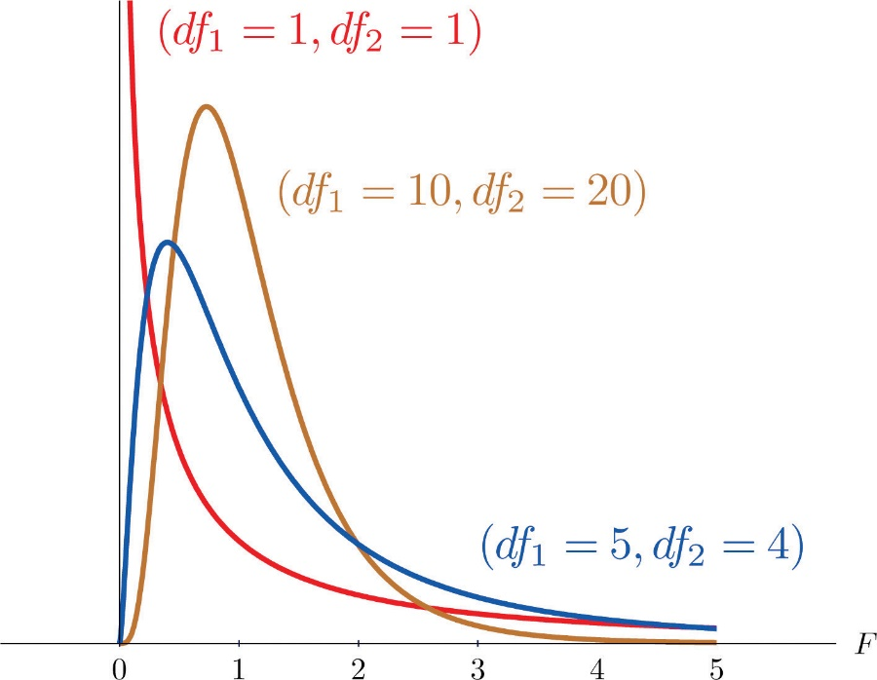
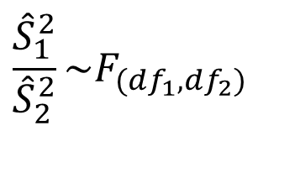
ANOVA and the F distribution
A rule (without proof*):
The ratio between two independent statistics that estimate the same variance follows the F distribution.
$$\frac{{\hat{S}}_{1}^{2}}{{\hat{S}}_{2}^{2}}\sim F_{(df_{1},df_{2})}$$
Figure from: https://saylordotorg.github.io/text_introductory-statistics/s15-03-f-tests-for-equality-of-two-va.html
* If you really want to get more mathematical intuition, contact me.

Slide 26
ANOVA and the F distribution
ANOVA stands for ANalysis Of VAriance
The idea: Two estimates that under H0 estimate the same variance
One estimate looks at the within-group variance. It always estimates the population variance (=error variance) [regardless of whether H0 or H1 is true).
Another estimate looks at the between-group variance.
Under H0 (=no effect, no real difference between groups), it will also estimate only the population (=error) variance.
Under H1 that’s no longer true (it also estimates the true impact of the independent variable).
If H0 is true (and only if it’s true), the ratio between these two estimates follows an F distribution.
As always in NHST: we assume no effect, compute this ratio, and see whether it’s “extreme enough” to reject H0.
If so, evidence that the IV did impact the DV.

Slide 27
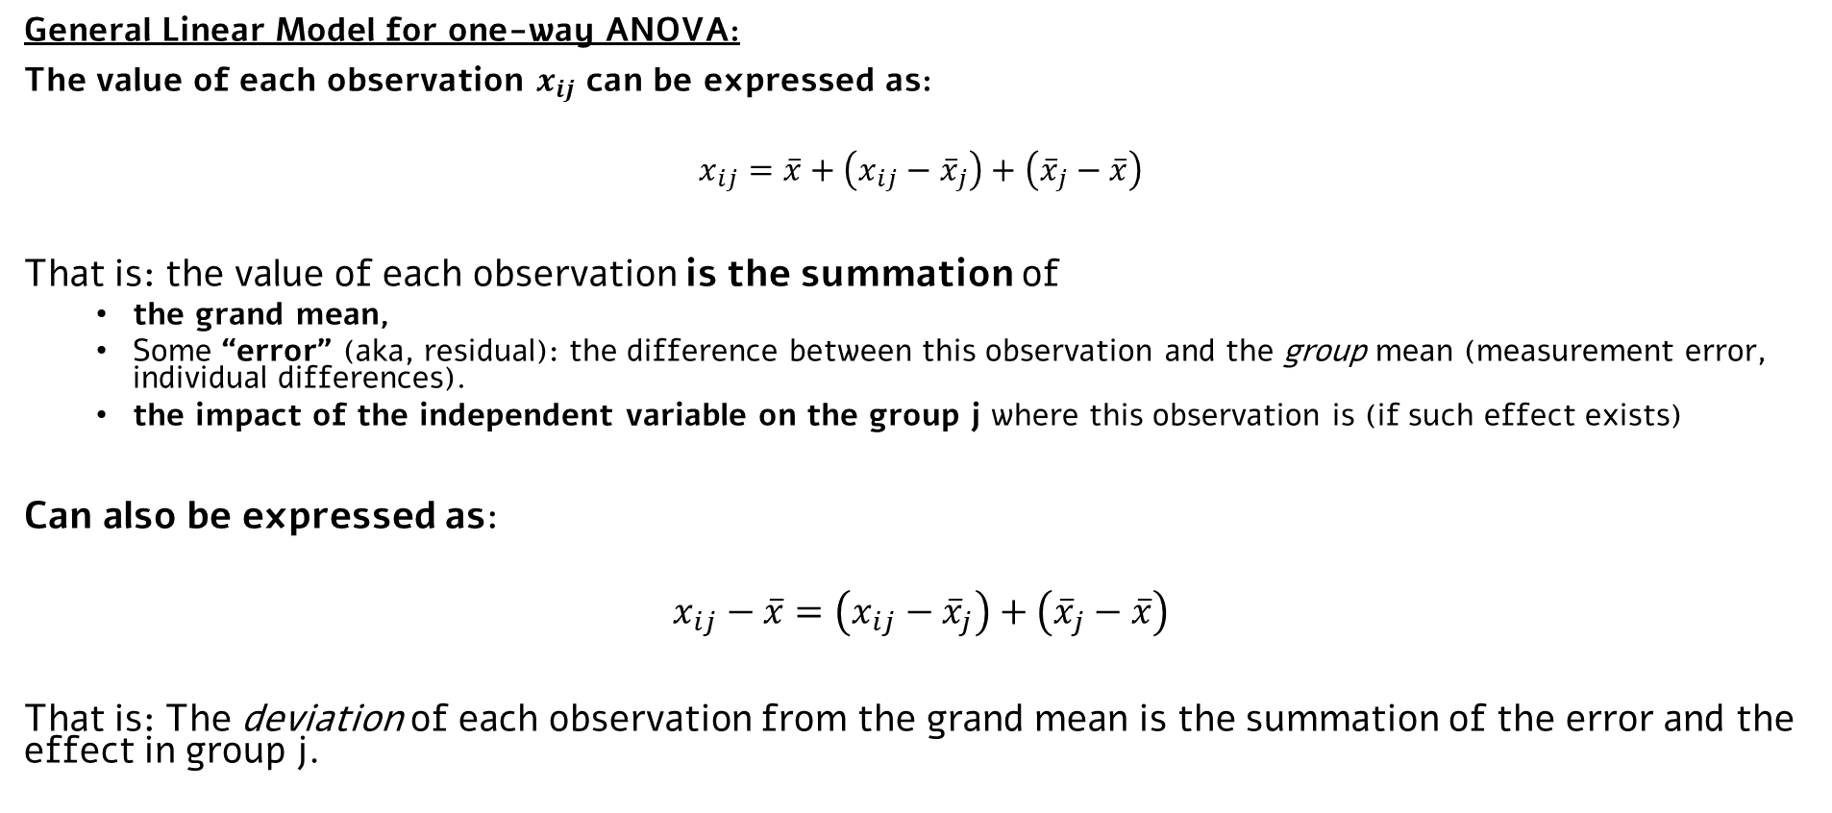
The two estimates: Variance between- and within-groups
General Linear Model for one-way ANOVA:
The value of each observation $x_{ij}$ can be expressed as:
$$x_{ij}=\overline{x}+\left(x_{ij}−{\overline{x}}_{j}\right)+\left({\overline{x}}_{j}−\overline{x}\right)$$
That is: the value of each observation is the summation of
the grand mean,
Some “error” (aka, residual): the difference between this observation and the group mean (measurement error, individual differences).
the impact of the independent variable on the group j where this observation is (if such effect exists)
Can also be expressed as:
$$x_{ij}−\overline{x}=\left(x_{ij}−{\overline{x}}_{j}\right)+\left({\overline{x}}_{j}−\overline{x}\right)$$
That is: The deviation of each observation from the grand mean is the summation of the error and the effect in group j.

Slide 28
The two estimates: Variance between- and within-groups
To get to our variance estimate, we don’t look at just one observation, but instead at the summation across all observations, and the squared error:
Some math:
Fixed within each group
=0
(sum of deviations from mean)

Slide 29
The two estimates: Variance between- and within-groups
And now we got to:
SST – total squared deviation of observations from grand mean
SSW – total squared deviation of observations from their group mean. Impacted by error variance.
SSB – total squared deviation of group means from grand mean. Impacted by both error variance and, if an effect exists, by the impact of the independent variable.
Sum of Squares
Total (SST)
Sum of Squares Within (SSW)
Sum of Squares Between (SSB)

Slide 30
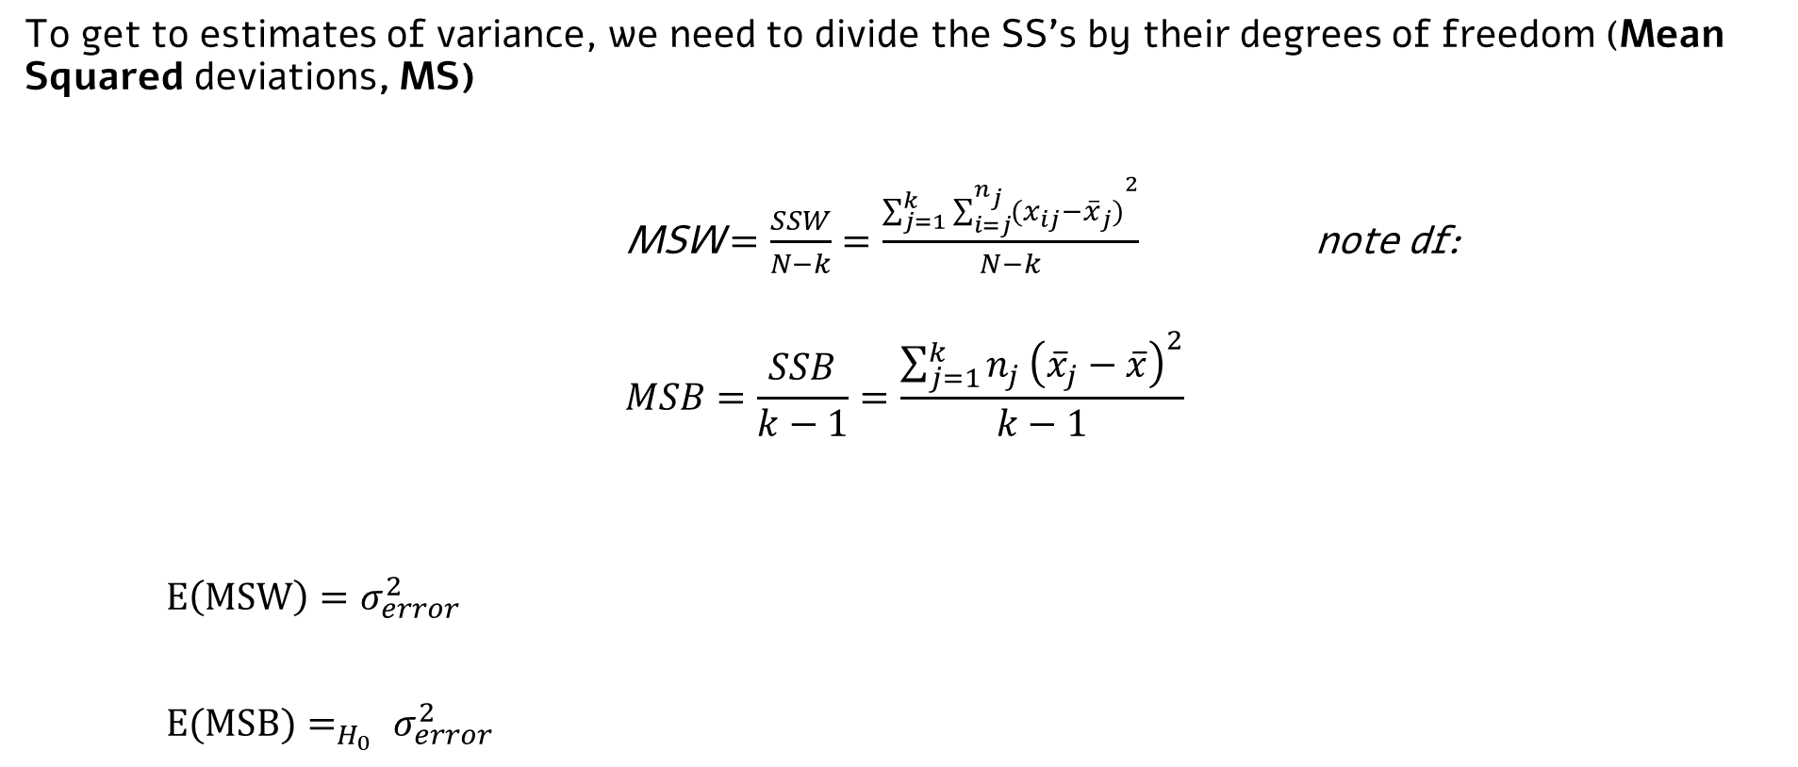

The two estimates: Variance between- and within-groups
To get to estimates of variance, we need to divide the SS’s by their degrees of freedom (Mean Squared deviations, MS)
MSW $=\frac{SSW}{N−k}=\frac{\sum_{j=1}^{k}{{\sum_{i=j}^{n_{j}}{(x_{ij}−{\overline{x}}_{j})}}^{2}}}{N−k}$ note df:
$$MSB=\frac{SSB}{k−1}=\frac{\sum_{j=1}^{k}{n_{j}}{\left({\overline{x}}_{j}−\overline{x}\right)}^{2}}{k−1}$$
$E\left(MSW\right)=σ_{error}^{2}$
$E(MSB)=_{H_{0}} σ_{error}^{2}$
$$F_{(k−1, N−k)}=_{H_{0}}\frac{MSB}{MSW}$$

Slide 31
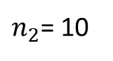
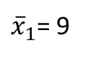
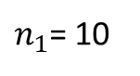
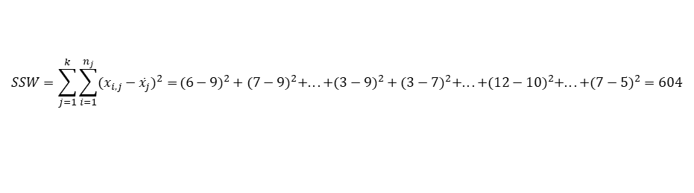
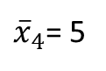
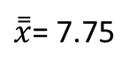
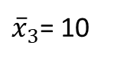
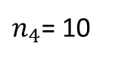
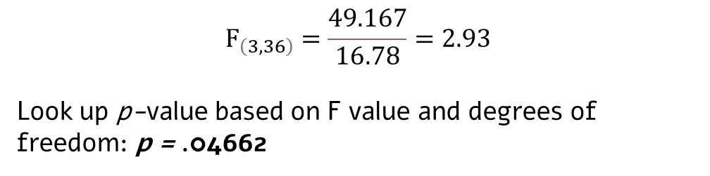
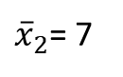
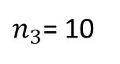
Back to our example…
$$SSW=\sum_{j=1}^{k}{\sum_{i=1}^{n_{j}}{(x_{i,j}−{\bar{x}}_{j})^{2}=}}(6−9)^{2}+(7−9)^{2}+...+(3−9)^{2}+(3−7)^{2}+...+(12−10)^{2}+...+(7−5)^{2}=604$$
Nashville (4) | Seattle (3) | Los Angeles (2) | New York City (1)
1 3 6 1 8 4 0 12 8 7 | 12 14 4 10 15 8 7 5 9 16 | 3 4 6 8 12 14 5 9 6 3 | 6 7 11 12 7 9 13 4 18 3
$$F_{\left(3,36\right)}=\frac{49.167}{16.78}=2.93$$
Look up p-value based on F value and degrees of freedom: p = .04662
${\overline{x}}_{1}$= 9
${\overline{x}}_{2}$= 7
${\overline{x}}_{3}$= 10
${\overline{x}}_{4}$= 5
$n_{1}$= 10
$n_{2}$= 10
$n_{3}$= 10
$n_{4}$= 10
$\overset{̿}{x}$= 7.75
What can be concluded?

Slide 32
One-way ANOVA: Assumptions
1. Independent and random sampling.
2. The dependent variable is normally distributed (at each level of the independent variable).
Although, ANOVA is relatively robust to violation of this assumption.
(If you ask: “how robust?” You now know how to find the answer ☺)
3. Homogeneity of variance.
Design implications: Use ANOVA when you expect an effect on means, but not on variance.

Slide 33
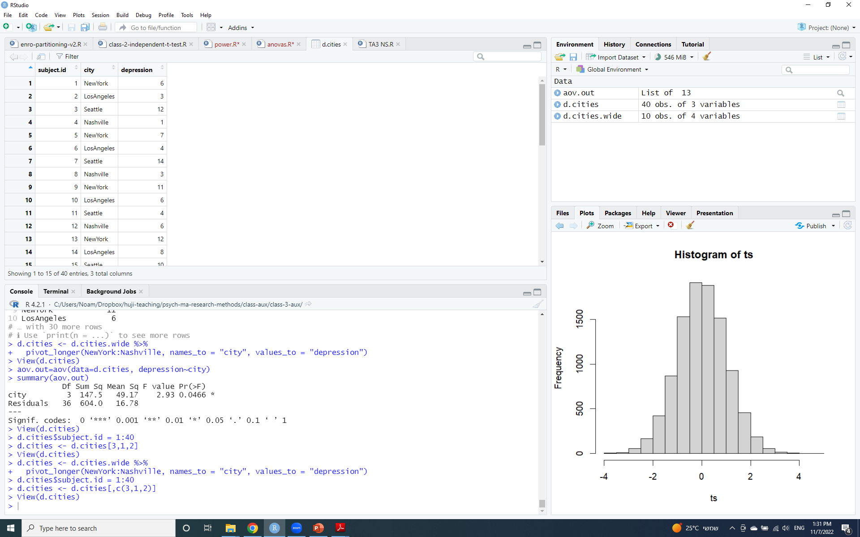
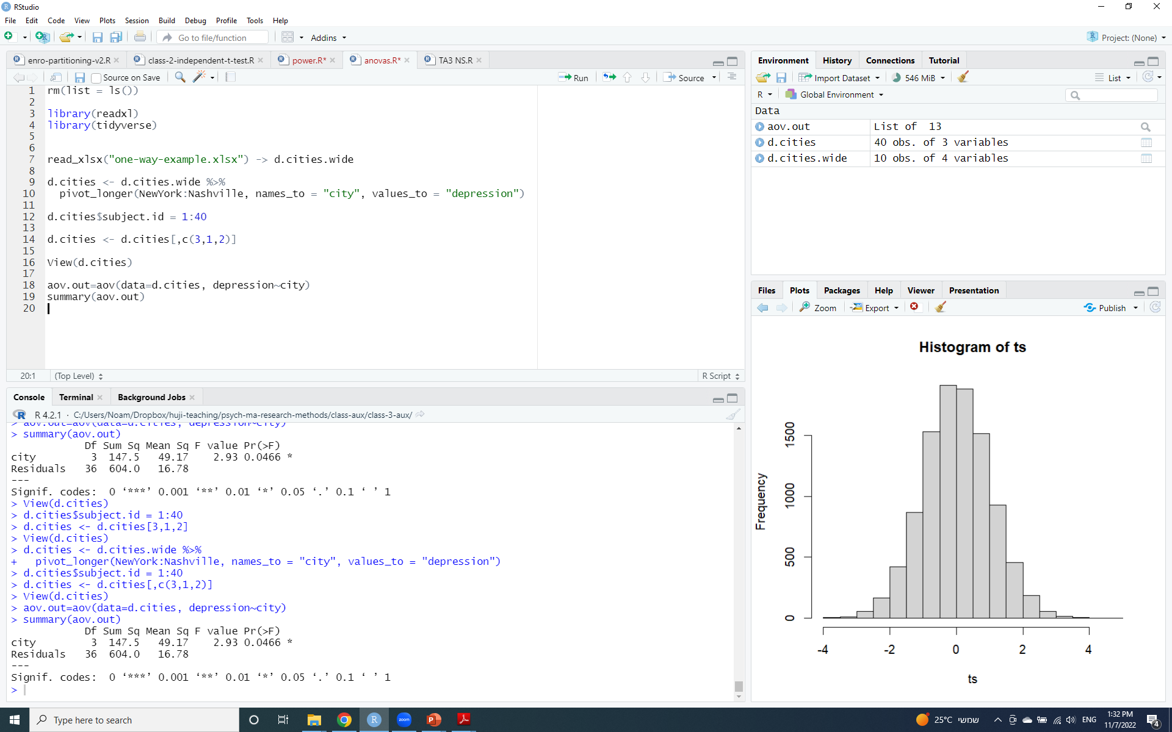
One-way ANOVA in R
Bring data to long format (each participant - one row):
Dependent variable in one variable (as a numeric).
Independent variable in another (as a factor).
What’s SSB/MSB in this output? What’s SSW/MSW? What’s SST?

Slide 34
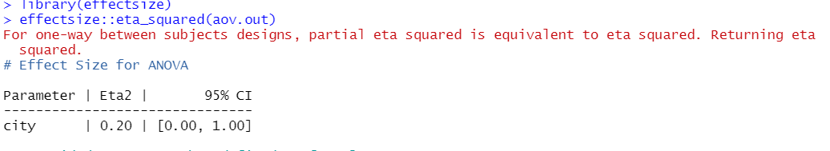
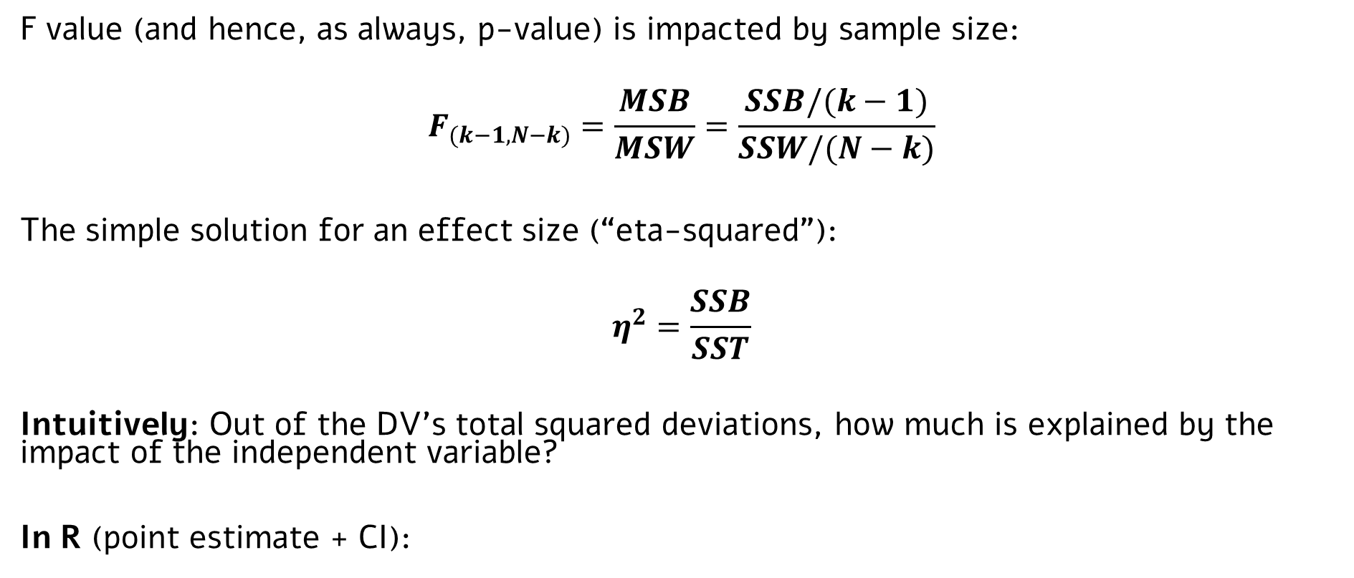
ANOVA: Effect size estimate
Better intuitions (and alternatives) soon, when we’ll discuss R² and the relation between linear models and ANOVA
F value (and hence, as always, p-value) is impacted by sample size:
$$F_{(k−1, N−k)}=\frac{MSB}{MSW}=\frac{SSB/(k−1)}{SSW/(N−k)}$$
The simple solution for an effect size (“eta-squared”):
$$η^{2}=\frac{SSB}{SST}$$
Intuitively: Out of the DV’s total squared deviations, how much is explained by the impact of the independent variable?
In R (point estimate + CI):
Why such wide CI?
Notes:
With very large sample sizes, N is high, denominator is small, F value is high regardless of the effect size.

Slide 35
Two-way ANOVA

Slide 36
More than one independent variable? Two-way (or X-way) ANOVA
All analyses so far: Impact of one independent variable on a dependent variable
Two sample t-test: independent variable with two levels.
One-way ANOVA: independent variable with more than two levels.
Two-way ANOVA: The impact of two independent variables on a dependent variable
Dependent variable still numeric.
Independent variables still categorical: two levels or more.
Examples:
Impact of city of residence and house ownership status on depression levels
Impact of priming condition and grammatical category on word identification RT
Impact of marital status and social network usage on social anxiety
…
We will look at the math for two-way ANOVA; can be generalizable to three-way, four-way, etc.
But before the math, some intuitions…

Slide 37
Some intuitions: Potential effects in a 2x2 design
How does marital status (married/single) and social network usage (yes/no) impacts social anxiety?
 | Uses Facebook | Doesn’t use Facebook
Married
Single
What are the hypothetical effects we can observe in this design?

Slide 38




Main effect: Rows
How does marital status (married/single) and social network usage (high/low) impacts social anxiety?
 | Uses Facebook | Doesn’t use Facebook
Married | 30 | 30
Single | 50 | 50
$${\overline{x}}_{1.}=30$$
$${\overline{x}}_{2.}=50$$
$${\overline{x}}_{.1}=40$$
$${\overline{x}}_{.2}=40$$
Notes:
In this case, people who are single have higher social anxiety. Facebook usage doesn’t impact social anxiety.

Slide 39




Main effect: Columns
How does marital status (married/single) and social network usage (high/low) impacts social anxiety?
 | Uses Facebook | Doesn’t use Facebook
Married | 50 | 30
Single | 50 | 30
$${\overline{x}}_{1.}=40$$
$${\overline{x}}_{2.}=40$$
$${\overline{x}}_{.1}=50$$
$${\overline{x}}_{.2}=30$$
Notes:
In this case, people who use facebook are more socially anxious than those who don’t. No difference between married and single people.

Slide 40


Main effects: Rows + Columns
How does marital status (married/single) and social network usage (high/low) impacts social anxiety?
 | Uses Facebook | Doesn’t use Facebook
Married | 50 | 30
Single | 70 | 50
$${\overline{x}}_{1.}=40$$
$${\overline{x}}_{2.}=60$$
$${\overline{x}}_{.1}=60$$
$${\overline{x}}_{.2}=40$$
Notes:
In this case, people who use facebook are more socially anxious than those who don’t. Single people are more anxious than married people.

Slide 41
A third possible effect: An interaction
How does marital status (married/single) and social network usage (high/low) impacts social anxiety?
 | Uses Facebook | Doesn’t use Facebook
Married | 30 | 50
Single | 50 | 30
$${\overline{x}}_{1.}=40$$
$${\overline{x}}_{2.}=40$$
$${\overline{x}}_{.1}=40$$
$${\overline{x}}_{.2}=40$$
Notes:
No main effects.
BUT: Among married people, those who use facebook are less anxious. Among single people, those who use facebook are more anxious.

Slide 42
A combination of multiple effects
How does marital status (married/single) and social network usage (high/low) impacts social anxiety?
 | Uses Facebook | Doesn’t use Facebook
Married | 30 | 30
Single | 70 | 30
$${\overline{x}}_{1.}=30$$
$${\overline{x}}_{2.}=50$$
$${\overline{x}}_{.1}=50$$
$${\overline{x}}_{.2}=30$$

Slide 43
How to test for these effects statistically?
In two-way ANOVA, we essentially run three NHST tests: For the effect of the rows, columns, and their interaction.
To test each effect, we use the same logic as in a one-way ANOVA: Look at a ratio between two variance statistics, which under the relevant H0 estimate the same parameter: The population variance.
The math is similar, too:
Look at the deviation of each observation from the grand mean, and split it into components.
Then, dissect SST into parallel components, which represent different sources of variance: The effects of the Rows, Columns, Interaction, and Error.

Slide 44










Some notations
 | 1 | 2 | … | K… | C
1 | $$x_{1,1,1} \\ x_{2,1,1}$$ … | $$x_{1,1,2} \\ x_{2,1,2}$$ … $$x_{n,1,2}$$ |  | $$x_{1,1,k} \\ x_{2,1,k}$$ … $$x_{n,1,k}$$
2 | $$x_{1,2,1} \\ x_{2,2,1}$$ ...
…
J… | $$x_{1,J,1} \\ x_{2,J,1}$$ … $$x_{n,J,1}$$ |  |  | $$x_{1,J,K} \\ x_{2,J,K}$$ … $$x_{n,J,K}$$
R
Every observation marked as $x_{ij,k}$
i – index of observation within group (“cell”)
j – index of row number
k – index of column number
${\overline{x}}_{j,k}$ - mean of cell j,k
${\overline{x}}_{j.}$ - mean of row j
${\overline{x}}_{.k}$ - mean of column k
$R$ - number of rows
$C$ - number of columns
n - number of observations (subjects) in group (assumed to be equal in all cells).
$\overset{̿}{x}$ - grand mean
N – total number of observations
$${\overline{x}}_{1.}$$
$${\overline{x}}_{2.}$$
$${\overline{x}}_{J.}$$
$${\overline{x}}_{R.}$$
$${\overline{x}}_{.1}$$
$${\overline{x}}_{.2}$$
$${\overline{x}}_{.K}$$
$${\overline{x}}_{.C}$$

Slide 45



The value of each observation is…
In population/expected value terms:
$$x_{i,j,k}=μ$$
$+\left(μ_{j.}−μ\right)$
$+\left(μ_{.k}−μ\right)$
$+\left(μ_{jk}−α_{j}−β_{k}−μ\right)$
+ ($x_{i,j,k}$- $μ_{jk})$
[grand population mean]
[$α_{j}:$effect in row j]
[$β_{k}:$effect in column k]
[$γ_{jk}$effect of combination of row j and column k]*
[error]
*Also expressed as:
$$γ_{jk}={μ_{jk}−μ}_{j.}−μ_{.k}+μ$$

Slide 46

Two-way ANOVA: The null hypothesEs
Three independent NHST procedures:
$$H0\left(rows\right):\sum_{j=1}^{R}{α_{j}^{2}}=0; μ_{1.}=μ_{2.}=...=μ_{R.}$$
$$H0\left(columns\right):\sum_{k=1}^{C}{β_{k}^{2}}=0; μ_{.1}=μ_{.2}=...=μ_{.C}$$
$$H0(interaction):\sum_{j=1}^{R}{\sum_{k=1}^{C}{γ_{jk}^{2}}}=0$$
What is the probability of finding an effect ‘accidently’ (i.e., when no true effects exist) in at least ONE of the NHST procedures in a two-way ANOVA?

Slide 47










Finding estimates for the variance
General Linear Model for two-way ANOVA:
The value of each observation $x_{ij}$ can be expressed as (in sample terms):
$$(x_{i,j,k}−\bar{x})=({\bar{x}}_{j.}−\bar{x})+({\bar{x}}_{.k}−\bar{x})+({\bar{x}}_{j,k}−{\bar{x}}_{j.}−{\bar{x}}_{.k}+\bar{x})+(x_{i,j,k}−{\bar{x}}_{j,k})$$
And when computing summed squared deviations: (trust me, all other terms are zero)
$$\sum_{j=1}^{R}{\sum_{K=1}^{C}{\sum_{i=1}^{n}{(x_{i,j,k}−\bar{x})^{2}}}}=\sum_{j=1}^{R}{nC({\bar{x}}_{j.}−\bar{x})^{2}}+\sum_{k=1}^{C}{nR({\bar{x}}_{.k}−\bar{x})^{2}}+\sum_{j=1}^{R}{\sum_{k=1}^{C}{n({\bar{x}}_{j,k}−{\bar{x}}_{j.}−{\bar{x}}_{.k}+\bar{x})^{2}}}+\sum_{j=1}^{R}{\sum_{K=1}^{C}{\sum_{i=1}^{n}{(x_{i,j,k}−{\bar{x}}_{j,k})^{2}}}}$$
$${\overline{α}}_{j}$$
$${\overline{β}}_{k}$$
$${\overline{γ}}_{jk}$$
$$e_{ijk}$$
$$SST$$
$$SSR$$
$$SSC$$
$$SSint$$
$$SSE$$

Slide 48

Finding estimates for the variance
Again, to get to estimates of variance, we need to divide the SS’s by their degrees of freedom (Mean Squared deviations, MS)
$$MSR=\frac{SSR}{R−1}$$
$$MSC=\frac{SSC}{C−1}$$
$$MSint=\frac{SSint}{\left(R−1\right)∗(C−1)}$$
$MSE=\frac{SSE}{N−RC}$ note df:

Slide 49

Finding estimates for the variance
And these estimates can now be used to run the three F tests!
Test effects of rows: $F_{(R−1, N−RC)}=_{H_{0}}\frac{MSR}{MSE}$
Test effects of columns: $F_{(C−1, N−RC)}=_{H_{0}}\frac{MSC}{MSE}$
Test effects of interaction: $F_{(\left(C−1\right)∗(R−1), N−RC)}=_{H_{0}}\frac{MSint}{MSE}$
Note: These are three independent NHST procedures. Type I error in each is alpha!

Slide 50



Two-way ANOVA in R
(We’ll save you the manual calculation of two-way ANOVAs…)
Bring data to long format:
Dependent variable in one column (as numeric)
Each of the independent variables in another column (as factors).
Run the model:
*Plotted using the cat_plot() function in the interactions package

Slide 51


Two-way ANOVA: Effect size estimate
Effect size estimates for two-way ANOVAs (and beyond) – “Partial eta-squared”
For a given effect A: $partial−η^{2}=\frac{SSA}{SSA+SSE}$
Intuitively: Out of the total deviations excluding the effect of other variables, how much is explained by the impact of the independent variable?
In R (point estimate + CI):
If you prefer non-partial version, see ?eta_squared
Better intuitions (and alternatives) soon, when we’ll discuss R² and the relation between linear models and ANOVA

Slide 52
Two-way ANOVA: Assumptions
1. Independent and random sampling.
2. Dependent variable (within each cell) is normally distributed.
3. Homogeneity of variance.
4. Equal sample size (N) in all cells.
Otherwise, tests of main effects and interactions are no longer independent.
A practical limitation – if it’s not the case, requires some alternative methods.

Slide 53
Next class
Let’s say we rejected a Null Hypothesis in one- or two-way ANOVA.
The implication: there’s some effect of an independent variable on the dependent variable – the DV’s population means are not equal in all levels of the IV.
But, where does this difference come from? What levels are different?
Contrasts, next week.
Plus, a discussion of Questionable Research Practices (aka “False Positive Psychology”) and their impact on reproducibility.

Slide 54
Extra slides

Slide 55


PPV calculation
Bayes theorem
$$p\left(H1 \right| reject H0)=$$
$$\frac{p\left(H1\right)∗p\left(reject H0 \right|H1 correct)}{p(reject H0)}=$$
$$\frac{p\left(H1\right)∗(1−β)}{p\left(H0\right)∗α+p\left(H1\right)∗(1−β)}=$$
$$\frac{R∗(1−β)}{α+R∗(1−β)}$$
Blue part is statistical power (1-$β$)
Denominator – probability to reject H0 is alpha when H0 is true or (1-beta) when H1 is true.
Divide both numerator and denominator by p(H0); R=p(H1)/p(H0)
=PPV
Back…

Slide 56




Increasing statistical power
One more thing to do to increase statistical power: Strive to minimize error variance by using reliability measures.
Refresher: Higher population variance → lower statistical power.
The true differences between individuals in our population (i.e., individual differences) are out of our control…
But the tools we use to measure performance are within our control.
Reminder, Classical Test Theory:
$$σ_{observed}^{2}=σ_{true}^{2}+σ_{error}^{2}$$
$$reliabilty=\frac{σ_{true}^{2}}{σ_{observed}^{2}}$$
Hence, more reliable measures → higher statistical power.
True variance
Measurement error
$$σ_{true}^{2}$$
$$σ_{error}^{2}$$
$$σ_{observed}^{2}$$

